Slide 1



SDSC Summer Institute
Subhasis Dasgupta & Jon Stephens
August 9th, 2024

Slide 2
Data Storage and management options
There are many options for storing information. Each has tradeoffs and benefits for particular use cases.
Examples:
Relational Databases, NoSQL Databases, In-Memory Databases, Data Warehouses, Data Lakes, Object Storage, File Storage, Distributed Databases, Time-Series Databases, Graph Databases, etc.

Slide 3
Knowledge Graphs:
Notes:
I'm sure many people have probably heard the term knowledge graph. And if you haven't worked with them before you may not know what they are and how they are different from other databases. I hope to be able to explain what they are in the simplest terms and explain what you can do with them. Then I will show you how we are using graph databases in our own research.

Slide 4
Knowledge Graphs are everywhere
Search Engines (Google Knowledge Graph)
Social Networks (Facebook Social Graph)
Natural Language Processing
Recommendation Systems
Data Integration
Notes:
Google: Used to enhance search results with information gathered from various sources.
Facebook: Captures the relationships between users and their interests, friends, and other activities on the platform.

Slide 5
Clearly Knowledge Graphs are helpful if they are so pervasive in many fields... But what are they?

Slide 6
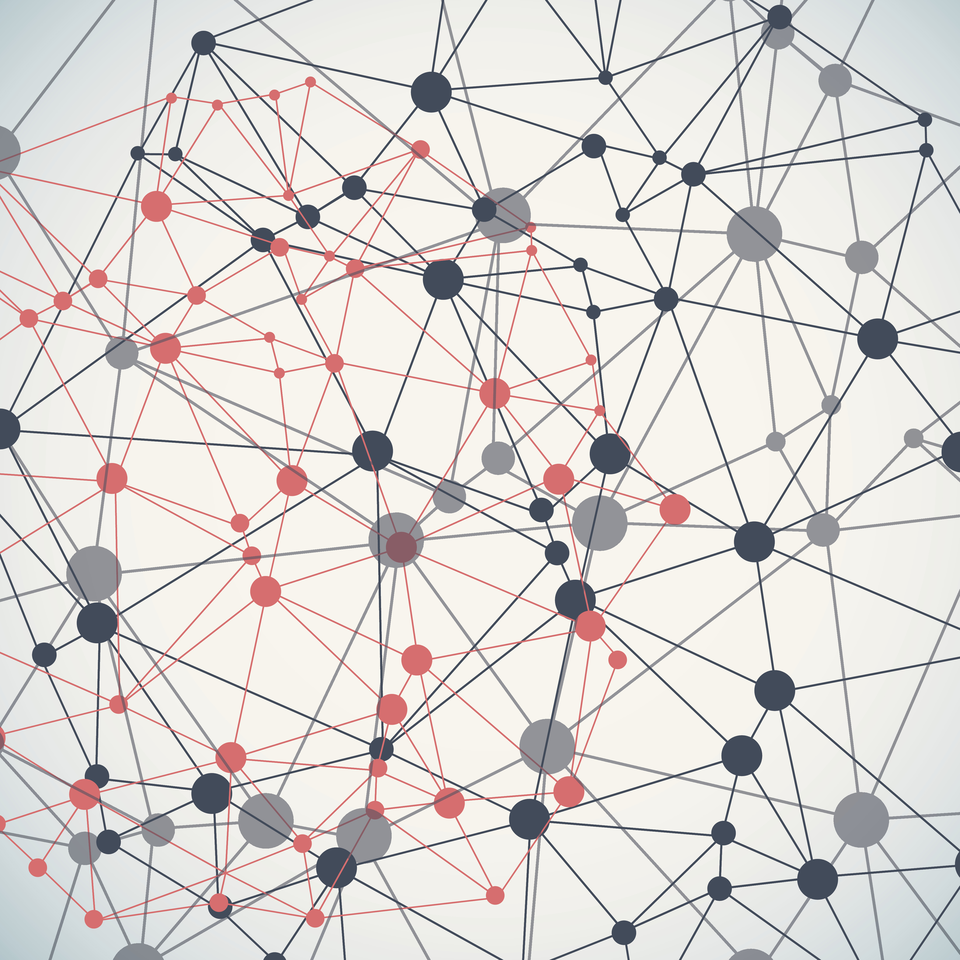
a Knowledge Graph
A knowledge graph is a structured representation of information that captures relationships between different entities, concepts, or data points.
Notes:
This cryptic explanation no doubt completely answers all your questions so I will pass it back to Subhasis. ** Jokes**
The biggest and best thing about knowledge graphs is that it is designed to model real-world knowledge in a way that is both understandable by humans and usable by computers.

Slide 7
What Do we want to save from this information?
RELATIONAL DATABASE EXAMPLE:
Information:
Alice, Bob, and Charlie are people.
They each live in a city (New York or Paris)
They each work in a job (Engineer or Doctor)

Slide 8
What we want:
Information:
Alice, Bob, and Charlie are people.
They each live in a city (New York or Paris)
They each work in a job (Engineer or Doctor)
All people
All cities
All jobs
All relationships between people jobs
All relationships between people cities

Slide 9
Possible Tables Needed For Relational Database:
Persons: A table to store information about people.
Cities: A table to store information about cities.
Occupations: A table to store information about occupations.
Person_City_Relationships: A table to store the relationships between persons and cities (i.e., where people live).
Person_Occupation_Relationships: A table to store the relationships between persons and their occupations.

Slide 10
What does this look like in A relational database?
PersonID | Name
1 | Alice
2 | Bob
3 | Charlie
PersonID | CityID | Relationship
1 | 1 | Lives in
2 | 2 | Lives in
3 | 1 | Lives in
CityID | CityName
1 | New York
2 | Paris
PersonID | OccupationID | Relationship
1 | 1 | Works at
2 | 2 | Works at
3 | 2 | Works at
OccupationID | Occupation
1 | Engineer
2 | Doctor

Slide 11
A question:
What How many people live in New York?
Of the people in new york, who is a doctor?

Slide 12
Who lives in New York and is a Doctor?
PersonID | Name
1 | Alice
2 | Bob
3 | Charlie
PersonID | CityID | Relationship
1 | 1 | Lives in
2 | 2 | Lives in
3 | 1 | Lives in
CityID | CityName
1 | New York
2 | Paris
PersonID | OccupationID | Relationship
1 | 1 | Works as
2 | 2 | Works as
3 | 2 | Works as
OccupationID | Occupation
1 | Engineer
2 | Doctor

Slide 13
Is there a better way to arrange the data so that we can see/get this information easier?

Slide 14
Is there a better way to arrange the data so that we can see/get this information easier?
Short Answer:
Yes. Use Knowledge Graphs.

Slide 15
wHAT MAKES UP A Knowledge Graph:
Entities and Nodes: A person, place, or thing (Stan Lee, San diego, marvel) Relationships and edges: a relationship between two things ( A – lives IN – B) Properties and Attributes: an aspect of a node that is not itself a node (cost of a book) Semantic Labels: (Stan Lee is a "person", San Diego is a "Place") Ontology: (Grounded terms within a known hierarchy – More on this later)
Notes:
These represent the objects or concepts in the knowledge graph. For example, entities can include people, places, things, or abstract concepts.
These describe the connections or relationships between entities. For instance, a relationship could describe how a person is related to a location, or how one concept is related to another.
Entities and relationships can have attributes that provide additional information. For example, a person entity might have properties like name, birthdate, and occupation.
Knowledge graphs often include semantic information that helps define the meaning of entities and relationships. This semantic layer makes the data more interpretable and useful for complex queries.
Many knowledge graphs are based on an ontology, which is a formal representation of a set of concepts and categories in a domain and their relationships.
Elements in a knowledge graph are nodes, edges, labels, and properties.

Slide 16
What Do we want to save from this information?
KNOWLEDGE GRAPH ENCODING
Alice, Bob, and Charlie are people.
They each live in a city (New York or Paris)
They each work in a job (Engineer or Doctor)

Slide 17
KNOWLEDGE GRAPH ENCODING
NODES:
Alice, Bob, and Charlie are people.
They each live in a city (New York or Paris)
They each work in a job (Engineer or Doctor)
Alice, Bob, Charlie, New York, Paris, Engineer, Doctor, (optional: Person, City)
Edges:
Alice – Lives in – New York
Bob – Works as – Doctor
Paris – Is a – City
Etc.

Slide 18

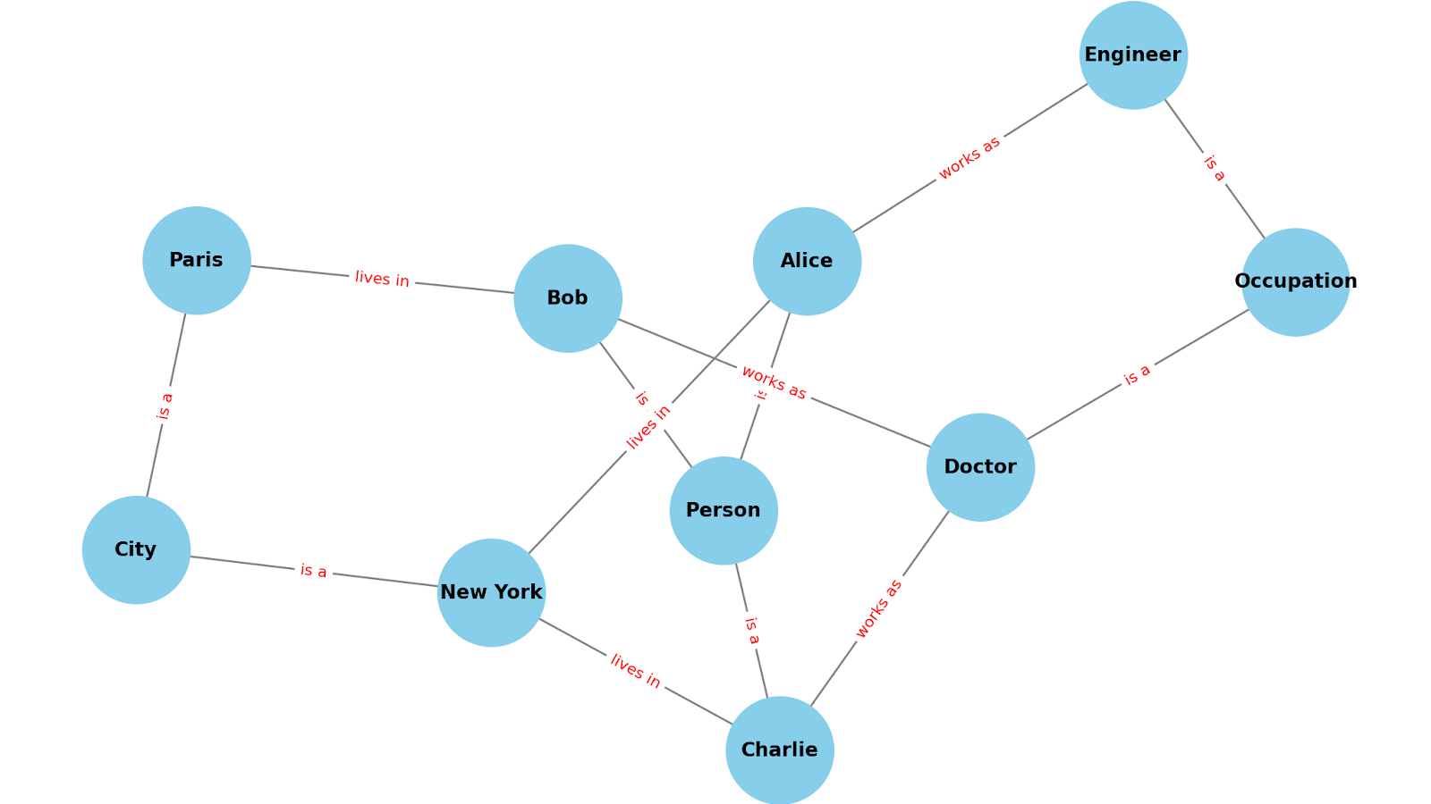

Slide 19
Who lives in New York and works as a doctor?

Slide 20
Who lives in New York and works as a doctor?

Slide 21
Who lives in New York and works as a doctor?

Slide 22
Who lives in New York and works as a doctor?
Answer: Charlie

Slide 23
Who lives in Paris and works as an Engineer?

Slide 24
Who lives in Paris and works as an Engineer?
Answer: None

Slide 25
When Would You Use Knowledge Graphs?
Complex and Interconnected Data
Dynamic and Evolving Schema
Semantic Queries and Reasoning
Data Integration from Diverse Sources
Knowledge Representation and Search
Contextual and Context-Aware Applications
Notes:
Knowledge graphs and relational databases both have their strengths, and the choice between them often depends on the specific use case and data characteristics. Here are some examples where a knowledge graph might be a better data storage technique than relational databases

Slide 26
1. Complex and Interconnected Data
Example:
In a social networking application, representing connections between users (friendships, followers, likes) is more naturally expressed in a knowledge graph, allowing for efficient queries like "suggest friends of friends."
Notes:
Knowledge graphs excel at handling complex relationships and connections between different entities. They can easily model and query multi-hop relationships, such as "Alice is a friend of Bob, who works with Charlie." This is particularly useful in domains like social networks, recommendation systems, and biological data, where relationships are rich and intricate.

Slide 27
2. Dynamic and Evolving Schema
Example:
In a research project, new relationships and entities may be discovered over time. A knowledge graph allows for easy integration of new data types and relationships without the need for complex database migrations.
Notes:
Knowledge graphs are flexible in terms of schema, allowing the addition of new types of nodes and relationships without significant restructuring. This flexibility is beneficial in scenarios where the data model evolves over time or is not fully understood at the outset.

Slide 28
3. Semantic Queries and Reasoning
Example:
In a medical knowledge graph, you can infer that if a patient has a disease that affects the liver and is prescribed a certain medication, they should avoid another medication that has negative interactions with liver conditions.
Notes:
Knowledge graphs can leverage ontologies and semantic information to enable advanced reasoning and inference. They support queries that go beyond simple data retrieval, allowing for understanding and interpreting the meaning behind the data.

Slide 29
4. Data Integration from Diverse Sources
Example:
In an enterprise setting, data might come from different departments or external sources with varying formats. A knowledge graph can integrate this data, preserving relationships and context, making it easier to analyze in a unified manner.
Notes:
Knowledge graphs are well-suited for integrating data from diverse sources, especially when the data comes in various formats or follows different schemas. They can unify disparate data into a coherent graph, making it easier to query and analyze.

Slide 30
5. Knowledge Representation and Search
Example:
In a search engine, a knowledge graph can store entities and relationships, allowing the engine to understand and respond to user queries more intelligently, such as providing direct answers to questions like "What is the capital of France?" rather than just listing web pages.
Notes:
For applications involving knowledge representation, such as natural language processing, chatbots, and intelligent search, knowledge graphs offer a more expressive way to store and query information compared to traditional relational databases.

Slide 31
6. Contextual and Context-Aware Applications
Example:
In a recommendation system, understanding the context of a user's preferences and their relationships with other entities (such as products, brands, or other users) allows for more accurate and relevant recommendations.
Notes:
Knowledge graphs enable applications to understand the context of the data and provide context-aware responses or insights, which is crucial in personalized services and adaptive systems.

Slide 32
How to make knowledge graphs

Slide 33
First a note on Ontologies:
An ontology is a structured framework used to describe the knowledge in a particular domain. It defines the types of entities (like objects, concepts, or individuals) and the relationships between them, creating a shared vocabulary that can be used to model the domain.

Slide 34
Key Features of Ontologies: (In Material Science)
Entities: Basic components, objects, concepts, or terms within the domain. (e.g. diamonds, hardness, opacity, etc.)
Relationships: How entities relate to each other. (e.g. diamond "has a property" like hardness or conductivity.)
Hierarchy: Ontologies often have a hierarchical structure, with more general concepts at the top and more specific ones below. (e.g "Metal" is a broad category, with "Aluminum" and "Steel" as specific types.)
Rules and Constraints: Ontologies can include rules or constraints that define how entities and relationships can or cannot be combined.

Slide 35
What makes an ontology special:
Shared Understanding: They provide a common understanding of a domain, which is useful for communication between people and systems.
Reusability: Ontologies can be reused across different applications and domains, making them versatile.
Reasoning: They support logical reasoning, allowing systems to infer new information or check the consistency of the data.

Slide 36
How do ontologies and knowledge graphs differ?

Slide 37
OntologY:
Definition: A formal, structured framework that defines the concepts, entities, and relationships within a particular domain. It serves as a blueprint or schema that specifies what kinds of things exist in that domain and how they can relate to each other.
Purpose: To provide a shared vocabulary and enable consistent data modeling and reasoning.
Components: Includes classes (or types), properties (or attributes), and relationships (or connections). It may also include rules and constraints to govern these elements.

Slide 38
Knowledge graph:
Definition: A data structure that uses the principles defined by an ontology to represent and store actual data about entities and their relationships. It consists of nodes (representing entities) and edges (representing relationships) that form a graph.
Purpose: To organize information in a way that makes it easy to retrieve, understand, and analyze, especially for complex queries and reasoning.
Components: Includes instances of entities (data points or real-world items) and the specific relationships between them, structured according to the rules and definitions provided by an ontology.

Slide 39
Key Differences
Conceptual vs. Data Level:
An ontology is conceptual and focuses on defining the structure and rules for a domain, while a knowledge graph operates at the data level, storing actual instances and their relationships.

Slide 40
Key Differences
Schema vs. Data:
An ontology serves as a schema or template for the knowledge graph, which contains the actual data. The ontology defines the types of nodes and edges, while the knowledge graph populates this structure with specific data.

Slide 41
Key Differences
Usage:
An ontology can exist independently of a knowledge graph and be used for various purposes, including data integration, semantic search, and reasoning. A knowledge graph, however, is typically built using an ontology and is used to manage and explore data in a structured way.

Slide 42
Ontology Example:
- Classes: "Person," "Book," "Author"
- Relationships: "writes" (Author -> Book), "reads" (Person -> Book)
- Attributes: For "Person": name, age; For "Book": title, genre

Slide 43
Knowledge graph example
- Nodes: "Alice," "Bob," "The Great Gatsby," "F. Scott Fitzgerald"
- Edges: "Alice reads The Great Gatsby," "F. Scott Fitzgerald writes The Great Gatsby"
- Attributes: Alice (name: "Alice", age: 30), The Great Gatsby (title: "The Great Gatsby", genre: "Novel")

Slide 44
Ontology vs Knowledge Graph
In summary, an ontology provides the structure and rules, and a knowledge graph uses that structure to store and manage data. They are complementary tools often used together to manage complex information systems.

Slide 45
Making a Knowledge graph
Data Collection and Preprocessing
Entity Recognition and Extraction
Ontology Development
Relationship Extraction
Data Integration and Knowledge Graph Construction
Iteration and Enrichment
Notes:
Data Collection and Preprocessing
Document Collection: Gather all research documents, which could include research papers, articles, patents, and reports. These documents may be in various formats such as PDFs, Word documents, or plain text files.
Text Extraction: Extract the text content from these documents. This may require specialized tools or libraries, especially for non-text formats like PDFs.
Preprocessing: Clean and normalize the text. This includes removing unnecessary formatting, tokenizing the text, handling stop words, and possibly stemming or lemmatizing words to their base forms.

Slide 46
Making a Knowledge graph
Data Collection and Preprocessing
Entity Recognition and Extraction
Ontology Development
Relationship Extraction
Data Integration and Knowledge Graph Construction
Iteration and Enrichment
Notes:
Entity Recognition and Extraction
Named Entity Recognition (NER): Identify and classify entities within the text. In the context of material science, entities could include materials (e.g., graphene, silicon), chemical compounds, properties (e.g., conductivity, hardness), processes (e.g., synthesis methods), and researchers or institutions.

Slide 47
Making a Knowledge graph
Data Collection and Preprocessing
Entity Recognition and Extraction
Ontology Development
Relationship Extraction
Data Integration and Knowledge Graph Construction
Iteration and Enrichment
Notes:
Ontology Development
Ontology Development: Develop an ontology or schema that defines the types of entities and relationships relevant to material science. This schema serves as the backbone of the knowledge graph, guiding how data is structured and interconnected.

Slide 48
Making a Knowledge graph
Data Collection and Preprocessing
Entity Recognition and Extraction
Ontology Development
Relationship Extraction
Data Integration and Knowledge Graph Construction
Iteration and Enrichment
Notes:
Relation Extraction
Relation Extraction: Identify relationships between entities. This involves determining how different entities are connected, such as a material having a specific property or being synthesized using a particular method.
Contextual Analysis: Understand the context in which entities are mentioned to accurately determine relationships. This might involve sentence-level parsing, dependency analysis, and semantic role labeling.

Slide 49
Making a Knowledge graph
Data Collection and Preprocessing
Entity Recognition and Extraction
Ontology Development
Relationship Extraction
Data Integration and Knowledge Graph Construction
Iteration and Enrichment
Notes:
Data Integration and Knowledge Graph Construction
Entity Resolution: Resolve different mentions of the same entity to a single unique identifier (e.g., different papers referring to the same material with slightly different names).
Graph Construction: Create nodes for each entity and edges for each relationship. The knowledge graph can be built using graph databases like Neo4j, which allow for the efficient storage and querying of graph-structured data.

Slide 50
Making a Knowledge graph
Data Collection and Preprocessing
Entity Recognition and Extraction
Ontology Development
Relationship Extraction
Data Integration and Knowledge Graph Construction
Iteration and Enrichment
Notes:
Iteration and Enrichment
Data Enrichment: Integrate additional data sources to enrich the knowledge graph. This could include external databases, public datasets, or supplementary documents.
Continuous Improvement: As new research is published, the knowledge graph should be continuously updated and refined. This requires setting up processes for regular data ingestion and updating.

Slide 51
Key points
There were two key steps that seem simple at first but are in fact tremendously complex.
Entity Recognition and Extraction
Relationship Extraction

Slide 52
Example – complexity of knowledge
Text: "At the fairground, visitors can enjoy a wide range of exciting activities and attractions."
Just like before, what is the information we want to extract from this text?
Who does this pertain to? What are the entities? What do they mean?
Are there location based semantic entities?
Is there expert knowledge?
What about definitions? Or logical statements? Etc.
Notes:
One sentence can have lots of information that we are missing by simply grabbing entities. For this reason, the extraction portion of the pipeline is crucial if you need to ensure that you are getting all the information held in the sentence, or at the very least the information necessary to fully encapsulate the meaning exactly as it is said.

Slide 53
Example – Extracting Named Entities
Text_1: "Jane Doe went to Home Depot to purchase plants."
Possible Named Entities: "Jane Doe", "Home Depot"
Text_2: "Jane Doe went to Lowes to purchase plants."
Possible Named Entities: "Jane Doe", "Lowes"
Where did Jane Doe go to purchase plants?
Both places? Only one? Are there two different Janes? How do we know?
Notes:
If Jane Doe is the same person and went to both stores, we must store the information that Jane went to both locations.
If Jane Doe is the same person and only one is incorrect, we want to store the correct only. Which one is correct? How could we know?
Worse still, if Jane Doe is not a named entity, then they may not be the same person at all and both statements are true, but pertain to two different people. How could we know?

Slide 54
Example – Extracting noun phrases
Text: "I eat red meat on days that end in 'day'."
Noun Phrases: "I", "red meat", "days that end in 'day' "
How do you decide that the phrases "red meat" and "days that end in 'day'" are one contiguous noun phrase, referring to one idea, rather than separate information? State of the art dependency parsers like spaCy provide these noun phrases:
[ 'I', 'red meats', 'days', 'that', 'day' ]

Slide 55
Example – Extracting Relationships
Harder still is this task:
Text: "In brittle materials, the rapid propagation of cracks leading to the material breaking apart into many smaller pieces, is a process known as shattering."
How do you recover the following relationship from the above text?
"Shatter" - PROCESS_DEFINITION - "the rapid propagation of cracks through a material that breaks it apart into many smaller pieces"
Notes:
This could be detected using declarative statements. "is a process known as" is a marker of a definition. But if we are to categorize all ways that a definition is created then we will invariably miss one and end up missing that information in the process.
How can we guarantee that a sentence is correctly ingested and the knowledge is distilled?

Slide 56
LLMs and Knowledge Graphs
Knowledge extraction from text can be assisted by LLMs in many ways.
Zero-Shot vs Few-Shot learning (Easiest)
Using the LLM for Data Augmentation (Easy)
Combining LLM with Rule-Based Systems (Moderate)
Customizing the LLM Output with Few-Shot Prompts (Moderate)
LLM-Assisted Annotation Tools (Moderate-Hard)
Fine-Tuning a Pretrained LLM (Hard)
Hybrid Models (Hard)
Notes:
Zero-Shot vs Few-Shot learning (Easiest) - Use the LLM without extensive fine-tuning, leveraging its existing knowledge to perform NER.
Using the LLM for Data Augmentation (Easy) - Use the LLM to generate more training data for a traditional NER model.
Combining LLM with Rule-Based Systems (Moderate) - Combine the power of LLMs with rule-based methods to improve NER accuracy.
Customizing the LLM Output with Few-Shot Prompts (Moderate) - Extract specific types of entities by crafting custom prompts.
LLM-Assisted Annotation Tools (Moderate-Hard) - Speed up the annotation process for creating labeled datasets. Use the data engineers responses to perform active learning.
Fine-Tuning a Pretrained LLM (Hard) - Fine-tune a pretrained LLM (like GPT, BERT, RoBERTa) on a labeled NER dataset.
Hybrid Models (Hard) - Use the LLM as part of a hybrid system that combines different approaches for NER.

Slide 57
The question isn't "can you use llms", the question is "how to do this correctly and efficiently"
Some results from the literature and current research:
Split complex queries into several, hopefully parallel, simpler queries
Use LLMs/Rules Based systems to check outputs to better ensure results are correct.
Use several different methods, analyze the results, and create one hybrid result.
Use low-cost/free models for simple tasks if performance is maintained. Use expensive models only when necessary.
Scalability is an issue with LLMs. Can your pipeline deal with 1 million pages? What about the costs? Nominal costs on the small scale can become massive if not careful.

Slide 58
Questions

Slide 59

Contact details
Jon Stephens
jcstephe@ucsd.edu

